Slide 1

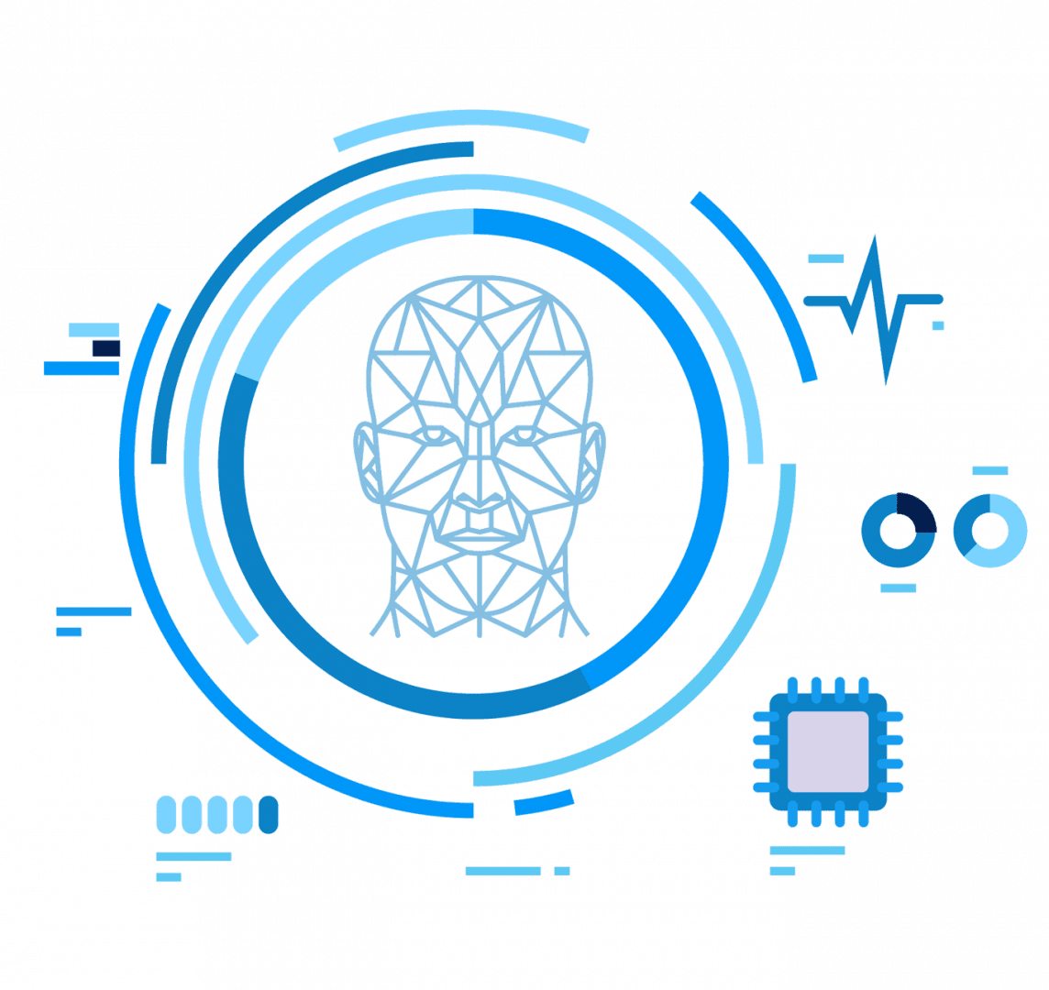
A Comparative Study for Self-Driving Cars: Integrating Behavioral Cloning, Path Planning, and NEAT
Guide
Presented by
Dr. Lekshmi K
Professor - Higher Academic Grade
School of Computer Science and Engineering, VIT Chennai
Vinayak Kumar Singh
23MCA1030

Slide 2

PROBLEM STATEMENT
LITERATURE REVIEW
Contents
OBJECTIVES
PROPOSED SOLUTION
ARCHITECTURE & DATASET
MODULES IDENTIFIED & DESCRIPTION
.

Slide 3
PROBLEM STATEMENT
The primary objective is to create a navigation system capable of self-driving on virtual environment. This involves:
Implementing Behavioral Cloning to replicate human-like driving behavior, enabling smooth and natural vehicle operation.
Developing Path Planning techniques to ensure structured and safe navigation through various road networks.
Utilizing the NEAT algorithm for evolutionary adaptation, allowing the system to improve over time and adapt to diverse driving conditions.

Slide 4
TECHNICAL CHALLENGES
Real-Time Sensor Fusion and Data Processing
The system must process and integrate data from multiple sensors, such as radar, LiDAR, and cameras, in real time to ensure accurate perception and decision-making.
Environmental Adaptation and Decision-Making
Adapting to dynamic road scenarios, including unpredictable traffic behavior and varying environmental conditions like weather and lighting, is critical for reliable navigation.
Robust Testing and Performance Consistency
Developing a realistic simulation environment for testing and ensuring the system performs consistently across diverse scenarios and road networks is essential for safety and effectiveness.

Slide 5
RESEARCH OBJECTIVE
Create sophisticated car racing simulation environment using Pygame.
Implement physics-based vehicle dynamics modeling.
Design real-time collision detection systems.
Develop comprehensive sensor simulation framework.
Build visualization tools for real-time monitoring

Slide 6
RESEARCH OBJECTIVE
Create sophisticated car racing simulation environment using Pygame.
Implement physics-based vehicle dynamics modeling.
Design real-time collision detection systems.
Develop comprehensive sensor simulation framework.
Build visualization tools for real-time monitoring

Slide 7
EVALUATION METRICS
Core Performance
Metrics Speed and acceleration measurement
Lane keeping accuracy
Obstacle avoidance capabilities
Number of manual takeovers required
Total driving mileage covered
Number of accidents/incidents
Advanced Metrics
Anthropomorphic index (comparing to human driving behavior)
Collision avoidance index in dangerous scenarios
Hardware performance metrics (sensors, actuators)
Software performance indicators
Environmental adaptability measures

Slide 8
LITERATURE REVIEW
S.No | TITLE(YEAR) | TECHNOLOGY USED | PROBLEM SOLVED | OBSERVATIONS
1 | Vehicle-in-Virtual-Environment (VVE) Method for Autonomous Driving System Development, Evaluation and Demonstration | The paper utilizes the Vehicle-in-Virtual-Environment (VVE) method for autonomous driving system development and testing. | It addresses the safety, cost, and inefficiency issues of testing autonomous vehicles on public roads. | The VVE method provides a safer, more efficient, and cost-effective approach to test autonomous driving functions in realistic yet controlled scenarios.
2 | Fast and accurate object detector for autonomous driving based on improved YOLOv5 | The paper utilizes an improved YOLOv5 algorithm enhanced by structural re-parameterization and neural architecture search. | It addresses the low detection accuracy of small vehicles and pedestrians in complex traffic environments. | The proposed model significantly improves detection accuracy and processing speed, making it a promising solution for autonomous driving applications.

Slide 9
S.No | TITLE(YEAR) | TECHNOLOGY USED | PROBLEM SOLVED | OBSERVATIONS
3 | Real-Time Object Detection Performance of YOLOv8 Models for Self-Driving Cars in a Mixed Traffic Environment | The paper utilizes the YOLOv8 deep learning framework for real-time object detection. | It addresses the challenges of accurately detecting objects in mixed traffic environments for self-driving cars. | The study concludes that YOLOv8 demonstrates robust performance, particularly YOLOv8x, but highlights the need for further improvements to handle complex scenarios effectively.
4 | An improved lightweight small object detection framework applied to real-time autonomous driving | The paper utilizes an improved YOLOv5 model with architectural modifications and kernel pruning techniques for small object detection. | It addresses the challenge of accurately detecting small objects, such as traffic signs and lights, in autonomous driving environments. | The proposed framework significantly enhances detection accuracy and speed while minimizing computational complexity, making it suitable for real-time applications in autonomous vehicles.
5 | Multi-Modal 3D Object Detection in Autonomous Driving: A Survey | The paper focuses on multi-modal sensor fusion, specifically integrating camera and LiDAR data for 3D object detection in autonomous driving. | It addresses the challenges of effectively fusing diverse sensor inputs to enhance perception accuracy in complex driving environments. | The survey highlights the evolution of fusion techniques and emphasizes the need for continued research to overcome existing challenges in multi-modal 3D object detection.

Slide 10
S.No | TITLE(YEAR) | TECHNOLOGY USED | PROBLEM SOLVED | OBSERVATIONS
6 | End-to-End Planning by Vision-language Model for Autonomous Driving on Carla Simulator | The paper employs a vision-language model with an auto-regressive transformer decoder for end-to-end autonomous driving planning. | It addresses the challenge of accumulated errors and information loss in traditional module-based autonomous driving systems by integrating planning as a language sequence generation task. | The proposed method achieved state-of-the-art performance on CARLA benchmarks, demonstrating its effectiveness and potential for real-world autonomous driving applications.
7 | Waymax: An Accelerated, Data-Driven Simulator forLarge-Scale Autonomous Driving Research | The paper utilizes a hardware-accelerated, differentiable simulator built on real-world driving data for autonomous vehicle research. | It addresses the challenges of speed and realism in simulating complex multi-agent interactions in autonomous driving scenarios. | Waymax demonstrates significant potential for improving the training and evaluation of autonomous driving systems while minimizing the sim-to-real performance gap
8 | Lane detection based on real-time semantic segmentation for end-to-end autonomous driving under low-light conditions | The paper employs the UET-STDC framework, integrating real-time semantic segmentation and the Zero-DCE++ image enhancement method. | It addresses the challenges of low lane detection accuracy and feature extraction difficulties in low-light driving conditions. | The proposed method significantly improves lane segmentation performance while maintaining real-time processing capabilities, enhancing the safety and efficiency of autonomous driving systems.

Slide 11
S.No | TITLE(YEAR) | TECHNOLOGY USED | PROBLEM SOLVED | OBSERVATIONS
9 | Autonomous Vehicle Simulation With Multi Human Driving Behavior Using Deep Learning | The paper utilizes deep learning techniques, specifically Convolutional Neural Networks (CNN), for autonomous vehicle simulation. | It addresses the challenge of simulating multi-human driving behaviors in autonomous vehicles to improve their decision-making capabilities. | The research demonstrates promising results with a 71% accuracy and suggests further optimization opportunities for enhancing autonomous vehicle performance.
10 | Choose Your Simulator Wisely: A Review on Open-Source Simulators for Autonomous Driving | The paper discusses various open-source simulators for autonomous driving, focusing on their functionalities and performance. | It addresses critical issues related to simulation fidelity, efficiency, and the validity of algorithms developed in these simulators. | The review emphasizes the need for improved realism and standardization in simulators to enhance the development and deployment of autonomous driving technologies.
11 | Autonomous Vehicles Using Udacity’s Self Driving Vehicles Simulator | The paper utilizes machine learning algorithms, specifically convolutional neural networks (CNN) and recurrent neural networks (RNN), for training autonomous vehicle models. | It addresses the challenge of training autonomous vehicles to navigate diverse driving environments effectively. | The study concludes that enhancing image processing and model adaptability is essential for achieving optimal performance in real-time driving scenarios.

Slide 12
S.No | TITLE(YEAR) | TECHNOLOGY USED | PROBLEM SOLVED | OBSERVATIONS
12 | 3D Object Detection for Autonomous Driving: A Comprehensive Survey | The paper utilizes 3D object detection technologies using LiDAR, cameras, and multi-modal sensor fusion for autonomous driving. | It addresses the challenge of accurately detecting and localizing objects in 3D space for reliable perception in autonomous vehicles. | The study concludes that while significant progress has been made, improvements in sensor integration and computational efficiency are crucial for advancing 3D object detection in real-time autonomous driving applications.
13 | MCS-YOLO: A Multiscale Object Detection Method for Autonomous Driving Road Environment Recognition | The paper employs the MCS-YOLO algorithm, incorporating a coordinate attention mechanism and Swin Transformer for enhanced object detection. | It addresses the challenges of low inference speed and accuracy in object detection for autonomous driving environments. | The MCS-YOLO algorithm significantly improves detection performance, achieving higher accuracy and real-time processing capabilities compared to existing models.
14 | Deep Learning-Based Image 3-D Object Detection for Autonomous Driving: Review | The paper focuses on deep learning-based methods for 3-D object detection using monocular and stereo camera images. | It addresses the challenges of obtaining accurate 3-D information from 2-D images in autonomous driving scenarios. | The study highlights the need for improved robustness and performance in 3-D object detection to enhance the safety and reliability of autonomous driving systems.

Slide 13
S.No | TITLE(YEAR) | TECHNOLOGY USED | PROBLEM SOLVED | OBSERVATIONS
15 | Radar-Camera Fusion for Object Detection and Semantic Segmentation in Autonomous Driving: A Comprehensive Review | The paper focuses on radar-camera fusion technology for enhancing perception in autonomous driving. | It addresses the challenges of integrating radar and camera data for improved object detection and semantic segmentation in various environmental conditions. | The review highlights the potential of radar-camera fusion to provide robust and reliable perception systems for autonomous vehicles, paving the way for future research and advancements in this field.

Slide 14
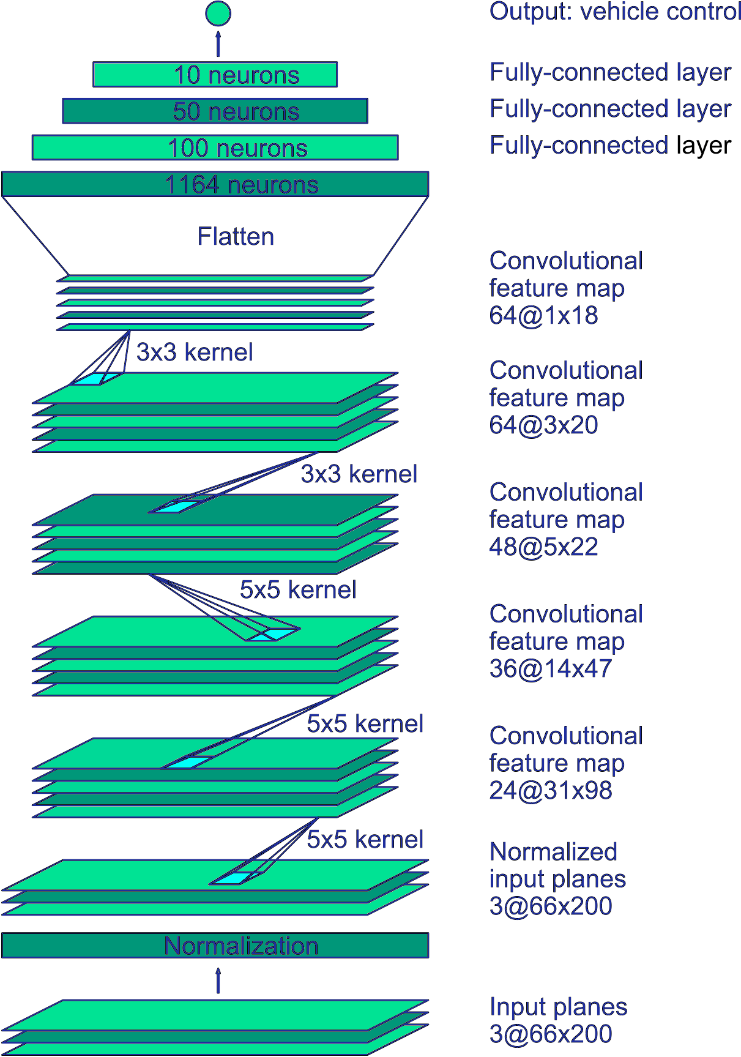
ARCHITECTURE
BEHAVIORAL CLONING IMPLEMENTATION
Core Components: Neural Network Architecture
Input layer: Processes visual image and sensor data
Hidden layers: Multiple convolutional and dense layers
Output layer: Steering and control decisions
Activation functions: ReLU for hidden layers
Training Process:
Data collection from human driving demonstrations
Image preprocessing and augmentation
Real-time sensor data processing
Gradient-based optimization

Slide 15
BEHAVIORAL CLONING IMPLEMENTATION

Slide 16
PATH PLANNING IMPLEMENTATION
Core Components
Environment Perception
Route Generation
Obstacle Avoidance
Real-time Decision Making
Algorithms
RRT (Rapidly-exploring Random Tree):
Explores space through random sampling
Builds tree-like structure from start point
Connects nodes until reaching goal
Handles complex environments efficiently
Model Predictive Control (MPC):
Enables real-time path adjustments
Predictive behavior modeling

Slide 17
PATH PLANNING IMPLEMENTATION

Slide 18
NEUROEVOLUTION OF AUGMENTING TOPOLOGIES (NEAT) IMPLEMENTATION
Core Architecture & Components:
Neural Network Structure
Input: 5 radar sensors for environmental perception
Output: 4 control decisions (steering, acceleration, braking, speed)
Dynamic topology evolution
Adaptive network complexity
Evolution Process
Population initialization with random genomes
Fitness evaluation based on:
Distance covered
Survival time
Navigation accuracy
Obstacle avoidance
Species management for genetic diversity
Natural selection mechanisms

Slide 19
NEUROEVOLUTION OF AUGMENTING TOPOLOGIES (NEAT) IMPLEMENTATION
Control Integration
Real-time sensor processing
Neural network decision making
Environmental adaptation
Performance feedback loops
Continuous learning system
This implementation enables autonomous vehicles to evolve increasingly complex neural networks that effectively control navigation while adapting to various driving conditions through continuous evolution and learning.

Slide 20
MISSING GAPS IDENTIFIED IN AUTONOMOUS VEHICLE NAVIGATION:
Limited research on combining evolutionary and traditional control approaches
Lack of seamless integration between different navigation methodologies
Need for unified frameworks that leverage multiple approaches' strengths
Real-time processing constraints in complex environments
Integration complexity between different approaches

Slide 21
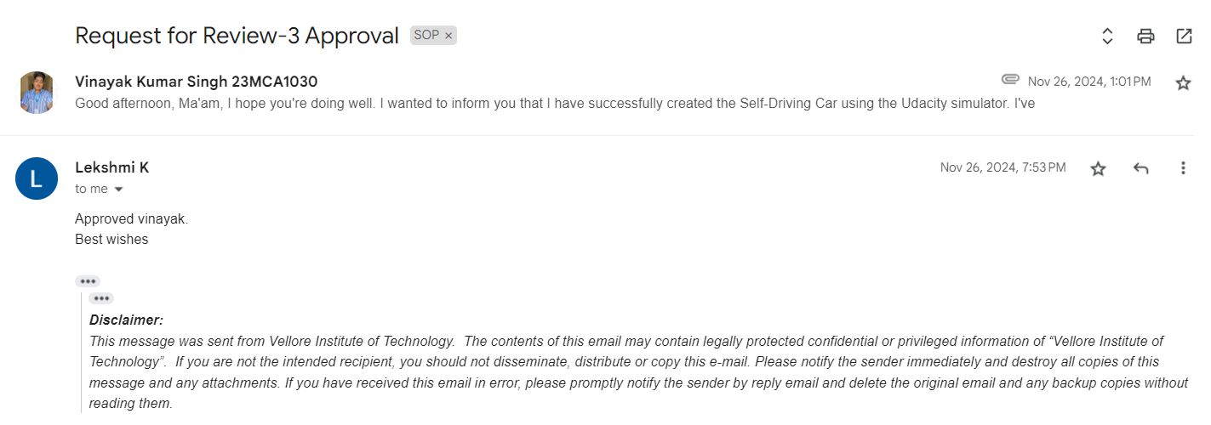
GUIDE APPROVAL

Slide 22


